Slide 1



Playground Leadership and Peer Mediation Program
Making the school a friendlier place and reducing the incidences of bullying

Slide 2

BUZ Rangers
PLAYGROUND LEADERSHIP
Being good role model in the playground
Helping kids play positively
Being a friend to all kids in the playground
Helping younger children with friendship issues
Make the playground a safer & positive place for everyone
Being a friendly face that kids can go to for help
Making the school a Build-Up Zone
Peer mediation

Slide 3

PEER MEDIATION:
A process that enables children to solve conflicts using a third person “Mediator” to assist them in finding an acceptable solution.
PEER =
a person the same
MEDIATION =
acting as a go between

Slide 4
Peer Mediation is:
Voluntary
Agreed to by both parties
Confidential
Focuses on the future
Has a no blame approach
Does not promote punishment or revenge

Slide 5
The mediator: (go between)
Remains neutral
Needs to know the steps in the mediation process
Understands and explains the guidelines
Works in pairs

Slide 6

Qualities of a BUZ Ranger
Good listener
Able to feel for others
Able to remain neutral
Likes to help others
A creative thinker
A good facilitator
Willing to put time into it
A good role model
Friendly and knows how to make friends
Able to keep confidences

Slide 7

What Strengths do you have that will make you a good BUZ Ranger?

Slide 8
Cooperating
Means working T.o.g.e.t.h.e.r.
Talk and listen to each other
Offer ideas and suggestions
Get ideas and suggestions from others
Encourage each other
Take it in turns and trust
Help each other
Enjoy each other
Reach your goals TOGETHER
T
O
G
E
T
H
E
R

Slide 9











How do you feel?

Slide 10
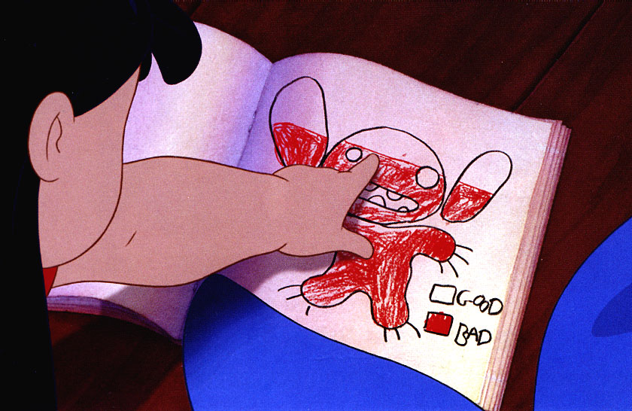

Slide 11
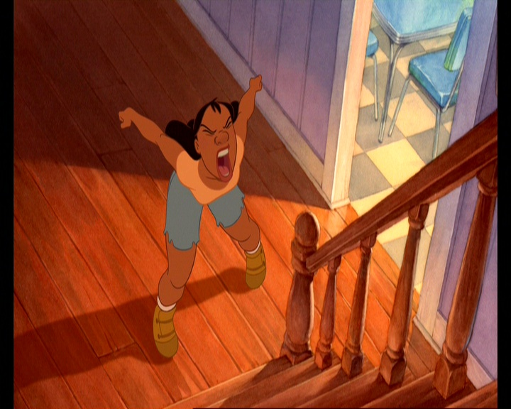
How do you let the angry feelings out?
Let the pressure out of your coke bottle!!

Slide 12
How do you let the angry feelings out?
© Nurture Works Foundation

Slide 13
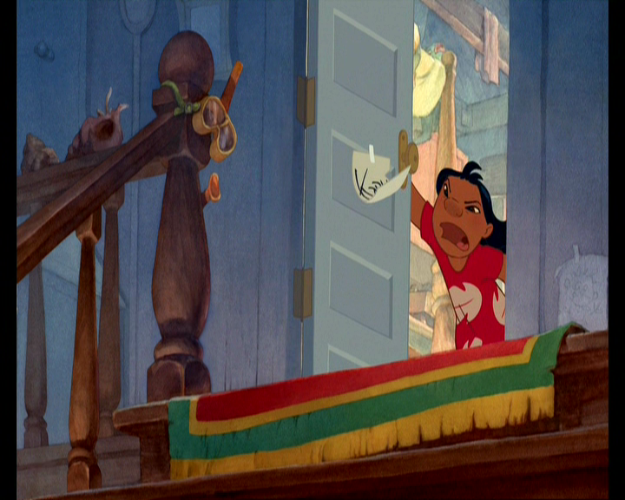
Let the pressure out of your coke bottle!!
© Nurture Works Foundation

Slide 14
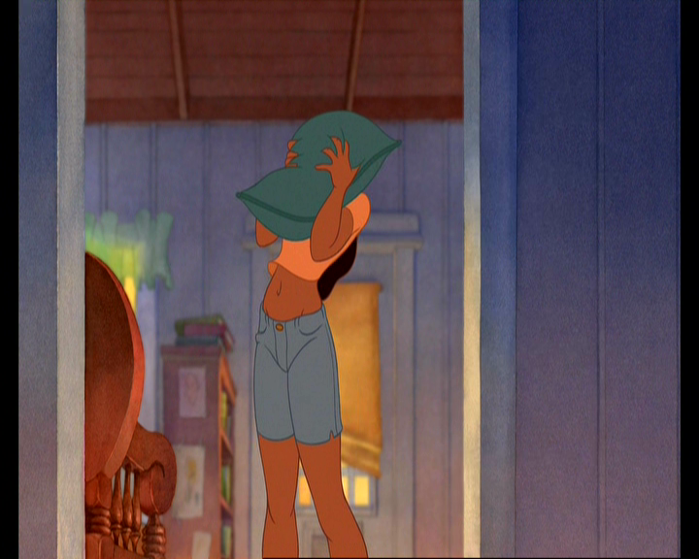
© Nurture Works Foundation

Slide 15
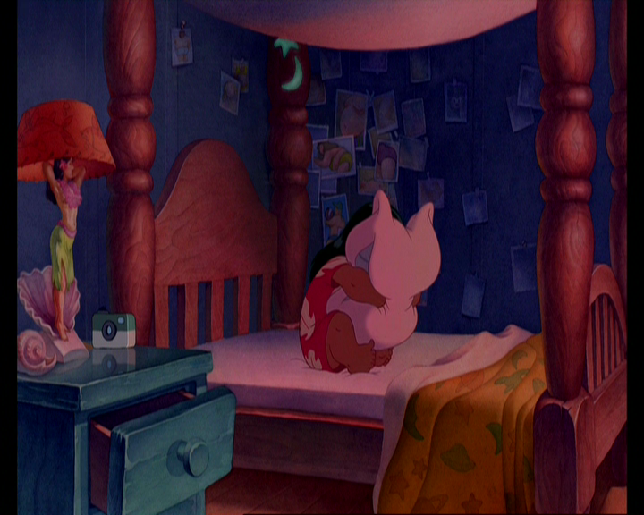
How do you let the angry feelings out?

Slide 16
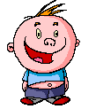

FEELINGS AND EMPATHY
Know how you feel
Say how you feel
Do something about how you feel
But don’t hurt anyone (including yourself)
Feelings are OK !!

Slide 17
FEELINGS AND EMPATHY
Empathy means being able to hear another persons story & understand how they are feeling
Empathy has three parts:
Listening and hearing how the other person is feeling
Understanding the situation that made them feel that way
Letting them know that you hear how they feel and that it’s ok to feel that way

Slide 18



Active Listening
LISTEN to feelings
LISTEN with your eyes
TUNING IN body, voice
ASKING questions
REFRAMING

Slide 19
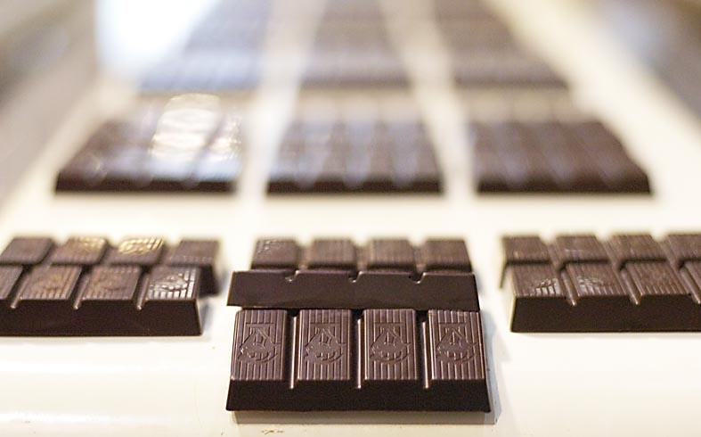



Slide 20
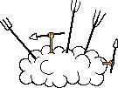

C O N F L I C T !!
Throwing a spanner in the works
What causes fights?

Slide 21




Ways of handling conflict
Might is right
Fight – attack – aggression
Punch, yell or swear first
You’re not gonna hurt me!
Run away or hide
Wimpish – lower head – give in
I’ll get them
Getting even (revenge)
Sly – keeping anger inside ready to snap
Peacemaker
Conflict there to be solved
Challenge not a problem
Work it out – talk it out
Win Win
Complain, winge & cry
Make a big fuss
Go and tell (dob)

Slide 22
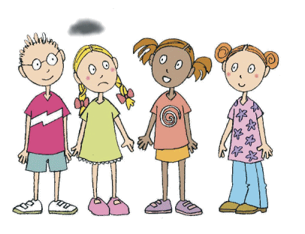
If your friendship factory breaks down -
you don’t close it up
and go out of business
You fix it up!

Slide 23








Solving Fights
The Hopscotch Conflict Resolution Method

Slide 24
Peer Mediation – The Process
Ask
What happened
Feelings
Listen
Problem
6. Options
7. Choose
8. Fix
9. Thanks
10. Check

Slide 25
Peer Mediation – Ground Rules
Both must agree to sort it out
Only one person talks at a time - without interrupting
No name calling or swearing (or hitting)
Work towards solving the problem
Don’t “MAKE” them say sorry to each other

Slide 26
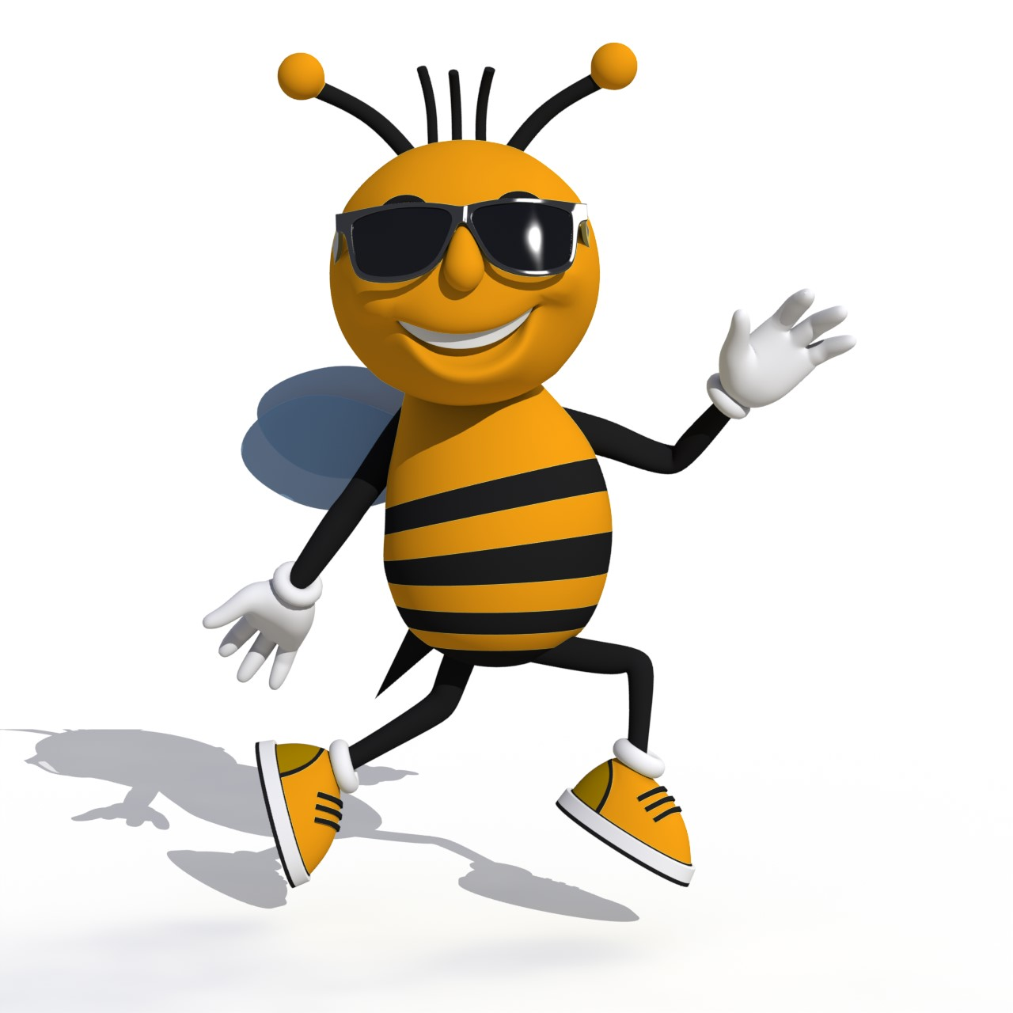
Gimme 5
Ways to
Bully-proof
yourself

Slide 27
Gimme 5
5 Ways to Bully-proof yourself
1. Walk
The Weak Way

Slide 28
Gimme 5
5 Ways to Bully-proof yourself
1. Walk
The agro way

Slide 29
Gimme 5
5 Ways to Bully-proof yourself
1. Walk
The Cool Way

Slide 30
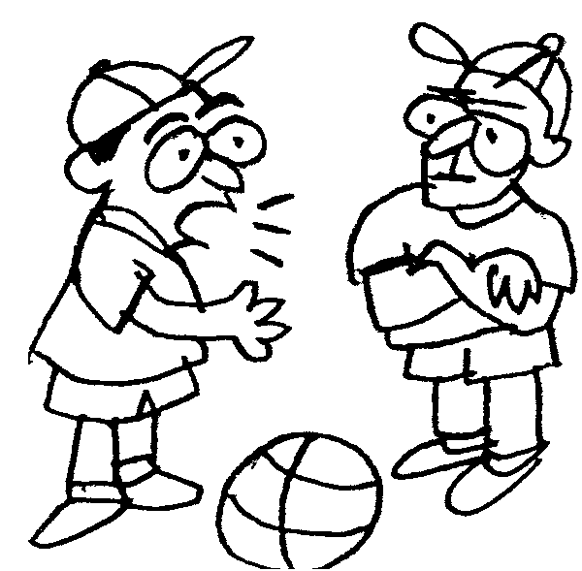
Gimme 5
5 Ways to Bully-proof yourself
2. Talk

Slide 31


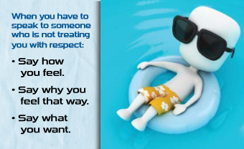

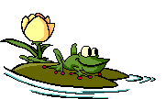
OK ?
Get
Help
Gimme 5
SORRY
5 Ways to Bully-proof yourself
2. Talk
STOP
ASK
TELL
SAY
© Nurture Works Foundation

Slide 32
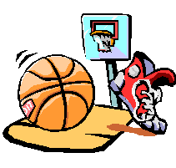
Humour
Gimme 5
Agree
5 Ways to Bully-proof yourself
3. Bounce…
Compliment
Invite
…back a retort
Be clever but friendly with your words

Slide 33

Gimme 5
5 Ways to Bully-proof yourself
4. Get Help
…when you need it

Slide 34
Getting help is a sign of strength not weakness
Gimme 5

Slide 35

Gimme 5
5 Ways to Bully-proof yourself
5. Bully Shields

Slide 36
Elements to Make a Build-Up Zone
Treat others as you want them to treat you
The BUZtastic Rule
Gimme 5

Slide 37
S.N.A.C.K.
HOW TO
MAKE A
FRIEND

Slide 38
S
HOW TO MAKE A FRIEND
Smile
A smile is a friend magnet
A smile is the same in any language

Slide 39
N
HOW TO MAKE A FRIEND
Name
Find out their name, use it
and tell them yours

Slide 40
A
HOW TO MAKE A FRIEND
Ask
Ask them if they want to play,
Don’t boss them

Slide 41
C
HOW TO MAKE A FRIEND
Care & Share
And be fair
Build trust and cooperation

Slide 42
K
HOW TO MAKE A FRIEND
Keep
Get to really know them
Good friendships take some work

Slide 43

CONGRATULATIONS
On completing the
BUZ Rangers Training
May the Power of BUZ be with you!
© Nurture Works Foundation

